Slide 1


Predicting the Next Hit Song

Slide 2






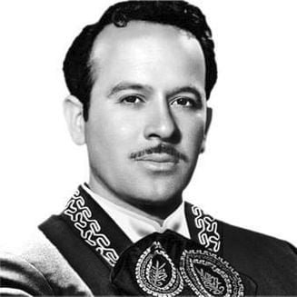
Premium
Alex
Featured Artists
Featured Artists
Background
Agenda
Data Cleaning
EDA
Dashboard
Data Modeling
Conclusion
Impact
Alex Barker
Pedro Infante
Alan Walker
Selena Gomez
Future Work
Artist
Artist
Artist
Artist

Slide 3


Premium
Alex
Featured Artists
Background
Introduction
Agenda
Background
Data Cleaning
EDA
Dashboard
The music industry makes up a large part of the economy, the global music market generated about $25.9 billion in 2021, and about $15 billion in the US music market. About 84% of that revenue was digital streaming. Music streaming applications create revenue through streaming numbers.
Given that so much money is tied up in these metrics, it would theoretically be in the interest of the music industry to generate music that is likely to gain higher numbers of streams and therefore generate more revenue.
Data Modeling
Conclusion
Impact
Problem Statement
Business Scope
Future Work
Is popular music formulaic? If so, can popularity be predicted?
Help artists and record labels streamline their music production and thus maximize their revenue.

Slide 4


Premium
Alex
Featured Artists
Background
Today’s Presentation
Agenda
Agenda
Data Cleaning
EDA
Dashboard
#
Title
Artist
Tools
Data Modeling
1
Data & Data Cleaning (Remix)
Airis Wang
Python, Pandas, Jupyter
02:00
Conclusion
2
Exploratory Data Analysis
Makafui Ama
Seaborn & Matplotlib
02:30
Impact
3
Dashboard
Jesus Meza
Looker Studio
03:30
Future Work
4
Data Modeling
Alex Barker ft. Makafui Ama
Brought to You by Statistics
04:30
5
Conclusion
Makafui Ama
Scikit-Learn
06:00
6
Impact
Akinola Onisile
Figma
06:30
7
Future Analysis
Alex Barker
Machine Learning
07:30

Slide 5
Premium
Alex
Welcome
Featured Artists
Background
Data
About Us
Agenda
Agenda
Our data was obtained from a Kaggle dataset pulled from Spotify’s API using its Audio Analysis feature, which allows us to quantify audible features in music tracks.
Informational features include track, artist, and URI (unique identifier)
Musical features such as key (1:C, 2:C#, etc.), loudness (db), mode (1:major, 0:minor), tempo (bpm), duration (milliseconds), time_signature (per measure), chorus_hit, sections.
Confidence measures such as energy, instrumentalness, acousticness, speechiness, liveness, valence
Calculated variables such as danceability (combination of musical elements: tempo, rhythm stability, beat strength, and overall regularity)
Target variable is target which is the popularity indicator (1 = popular, 0 = unpopular) as determined by the Top 100 charts.
Agenda
Data Cleaning
Our Services
EDA
Achievements
Dashboard
Our Goals
Data Cleaning
Data Modeling
Conclusion
Gallery
We examined each feature, and looked at the minimum, maximum, distribution, null values, zero values, duplicates, and significant outliers. Features requiring adjustment:
Adjust tracks where the loudness feature exceeds 0 (range is -60 to 0)
Drop erroneous track (Etta James’ Trust in Me from 60s dataset)
Convert duration from milliseconds to minutes
Overall, our data was relatively clean.
Pricing
Impact
Contact Us
Future Work
Play
Follow

Slide 6
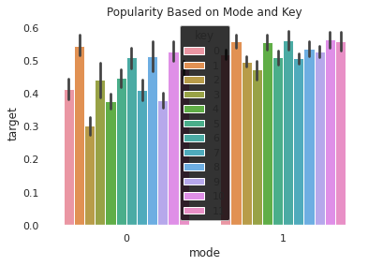
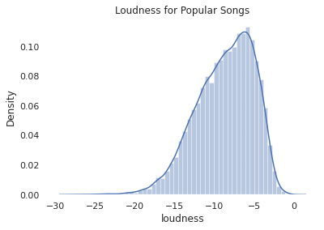
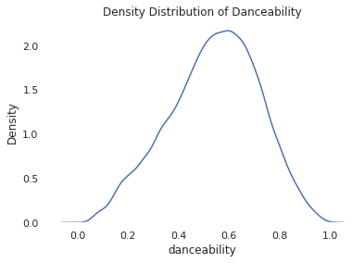
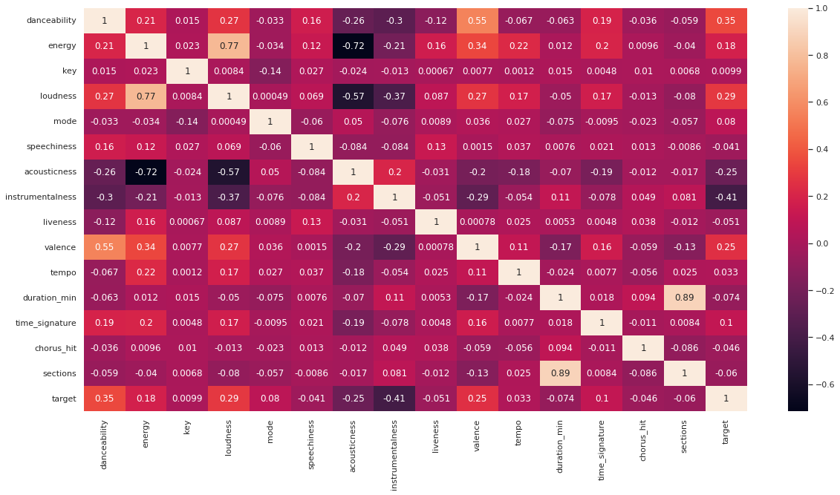
Premium
Alex
Welcome
EDA
Featured Artists
Background
About Us
Feature Exploration
Distribution Analysis
Our Teams
Agenda
Popularity Based on Mode and Key
Distribution of Loudness for Popular Tracks
Agenda
Data Cleaning
Our Services
EDA
Count
target
key
Achievements
Dashboard
mode
loudness
Our Goals
Data Modeling
Density Analysis
Correlation Analysis
Conclusion
Gallery
Density Distribution of Danceability
R² = 0.12
Pricing
Impact
Density
Contact Us
Future Work
danceability
Single feature with strongest correlation to target variable: danceability

Slide 7
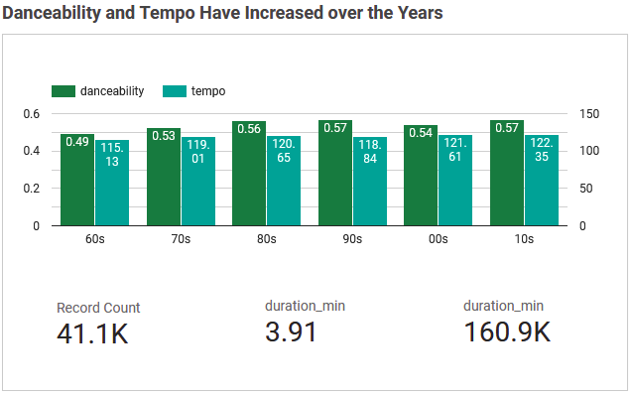
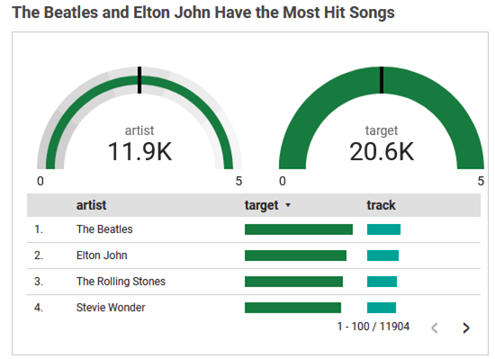

Premium
Alex
Welcome
Data Visualizations
Featured Artists
Background
About Us
Our Teams
Agenda
Agenda
Data Cleaning
Our Services
EDA
Achievements
Dashboard
Our Goals
Data Modeling
Conclusion
Gallery
Pricing
Impact
Contact Us
Future Work

Slide 8
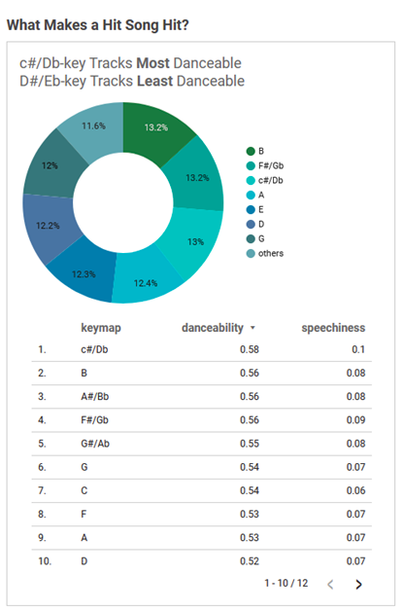
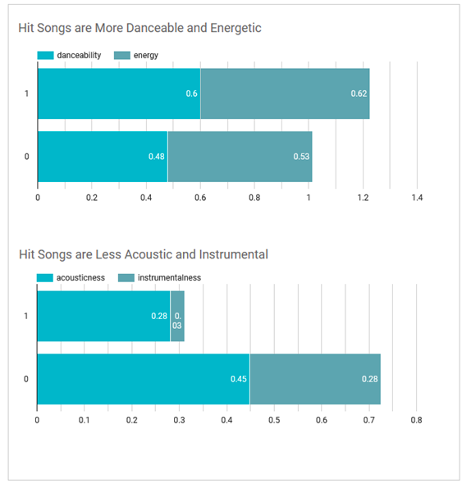
Premium
Alex
Welcome
Data Visualizations
Featured Artists
Background
About Us
Our Teams
Agenda
Agenda
Data Cleaning
Our Services
EDA
Achievements
Dashboard
Our Goals
Data Modeling
Conclusion
Gallery
Pricing
Impact
Contact Us
Future Work

Slide 9
Premium
Alex
Welcome
Model 1: Logistic Regression
Featured Artists
Background
About Us
Agenda
Play
Follow
Agenda
Agenda
Data Cleaning
Our Services
Logistic regression is a supervised classification algorithm. Particularly, binomial logistic regression is useful for us to predict a classification problem with only two classes (in our case, the target variable). Our data is too complex to use a linear function, we wanted to utilize the sigmoid curve of logistic regression to predict classification.
EDA
Achievements
>>>features = ['danceability', 'energy', 'key', 'loudness',
'mode', 'speechiness', 'acousticness', 'instrumentalness', 'liveness',
'valence', 'tempo', 'duration_min', 'time_signature', 'chorus_hit',
'sections']
>>>model2 = LogisticRegression()
>>>model2.fit(x_train, y_train)
>>>model2.score(x_test, y_test)
>>>log_pred = model2.predict(x_test)
Coefficient: [[ 2.23735132e+00, -1.48576478e+00 1.62010167e-02 8.51529536e-02
3.72205452e-01 -7.71785454e-01 -1.18929603e+00 -3.56034216e+00
-6.86962184e-01 5.21203756e-01 2.38662168e-03 -8.66324247e-02
1.46164516e-01 7.65305720e-04 2.57760429e-02]]
Intercept: [0.01051335]
Accuracy: 0.726
Dashboard
Our Goals
Data Modeling
Conclusion
Gallery
Pricing
Impact
Contact Us
Future Work

Slide 10
Premium
Alex
Welcome
Model 2: Decision Tree
Featured Artists
Background
About Us
Agenda
Play
Follow
Agenda
Agenda
Data Cleaning
Our Services
A decision tree is an algorithm that creates a tree-like model of decisions that calculates a strategy towards a particular goal.
We wanted to use our data to find the most accurate “path” through the tree. Decision Trees are relatively easy to visualize, we needed to use a classifier model to fit to our dataset and wanted to easily determine how it was making decisions.
EDA
Achievements
Dashboard
Our Goals
Data Modeling
>>>tree_model = DecisionTreeClassifier(criterion = "gini", random_state = 8, max_depth = 8, min_samples_leaf = 5)
>>>tree_model.fit(x_train, y_train)
>>>tree_ypredict = tree_model.predict(x_test)
Accuracy Score: 0.759
Conclusion
Gallery
Pricing
Impact
Contact Us
Future Work

Slide 11
Premium
Alex
Welcome
Model 3: Random Forest
Featured Artists
Background
About Us
Agenda
Play
Follow
Agenda
Agenda
Data Cleaning
Our Services
A Random Forest is an algorithm constructed by taking the mean of several decision trees. They are less prone to outliers and less likely to overfit than Decision Trees, and are therefore a logical next step for our model. We needed to combine many classifiers to look for complex solutions. Increasing the number of decision trees used increases the precision of the outcome.
EDA
Achievements
Dashboard
Our Goals
Data Modeling
>>>forest_model = RandomForestClassifier(n_estimators = 100)
>>>forest_model.fit(x_train, y_train)
>>>forest_ypredict = forest_model.predict(x_test)
Accuracy Score: 0.790
Conclusion
Gallery
Pricing
Impact
Contact Us
Future Work

Slide 12
Premium
Alex
Welcome
Confusion Matrix
Featured Artists
Background
About Us
Agenda
Play
Follow
Agenda
Agenda
Data Cleaning
Our Services
The Random Forest model correctly predicted the class of observations 54.9% when using all the variables.
EDA
>>>cmat = confusion_matrix(y_test, forest_ypredict)
>>>true_neg, false_pos, false_neg, true_pos = cmat.ravel()
>>>accuracy = ((true_neg+true_pos)/(true_neg+false_pos+false_neg+true_pos))
TP - True Negative 3012
FP - Flase Positive 1041
FN - False Negative 694
TP - True Positive 3475
Accuracy Score: 0.789
Misclassification Rate: 0.211
Achievements
Dashboard
Our Goals
Data Modeling
Conclusion
Gallery
Pricing
Impact
Contact Us
Future Work

Slide 13
Premium
Alex
Welcome
Featured Artists
Background
Conclusion
About Us
Our Teams
Agenda
Initially, we tried looking at individual correlation between the features and the target variable and found no strong correlations. Then we created several classification models to combine variables. We created models using Logistic Regression, Decision Trees, and Random Forest, and were able to come to a combination with an accuracy rate of 0.790 using the Random Forest model. We ranked the features by importance.
Agenda
Data Cleaning
Our Services
EDA
Most Important Features
Achievements
Dashboard
01
Instrumentalness
04
Energy
Our Goals
Data Modeling
Conclusion
Gallery
02
Acousticness
05
Loudness
Pricing
Impact
Contact Us
Future Work
03
Danceability
06
Speechiness

Slide 14

Premium
Alex
Welcome
Featured Artists
Background
About Us
So what?
Our Teams
Agenda
Impact
Agenda
Data Cleaning
Our Services
EDA
Using this information, it may help artists and record labels produce more popular “hit” music and therefore increase number of streams and revenue. However, other factors that may contribute to a track’s success are more difficult to measure, such as:
Social Media Presence and Following
Marketing Expenditures
Record Label
Previous Artist Success
Artist Networking Value
Additionally, individual music tastes are very different. If music becomes formulaic for the sake of increased revenue, music diversity, creativity, and artistry may decrease.
Achievements
Dashboard
Our Goals
Data Modeling
Conclusion
Gallery
Pricing
Impact
Contact Us
Future Work

Slide 15


Premium
Alex
Welcome
Featured Artists
Background
About Us
Despacito
Our Teams
Agenda
Future Work
Agenda
Data Cleaning
Our Services
Future continued analysis into this subject
EDA
More data:
We could pull in external data sources on artist popularity and marketing budgets.
Spotify
Achievements
Dashboard
Our Goals
Data Modeling
Despacito
Continuous target :
Luis Fonsi, Daddy Yankee
Conclusion
Target variable was placed into buckets (popular or not popular), additional data where popularity is a continuous variable allows us to look at regression models and create a more robust ranking.
Gallery
0:23
-3:25
Pricing
Impact
Future Work
Future Work

Slide 16

Questions?
Notebook:
https://drive.google.com/file/d/1HnCZQ6Qcdh1LO41s2RXz3xLB8iCJmiTz/view?usp=sharing
Dashboard:
https://lookerstudio.google.com/s/sA-BzdTScLc
Datafolio: https://drive.google.com/file/d/1SRxpfBoT14yg9_HEXQUlE8qO_Kpxvg5f/view?usp=sharing
Despacito
Luis Fonsi, Daddy Yankee
0:23
-3:25

